Slide 1

CamScanner

Slide 2

CamScanner

Slide 3
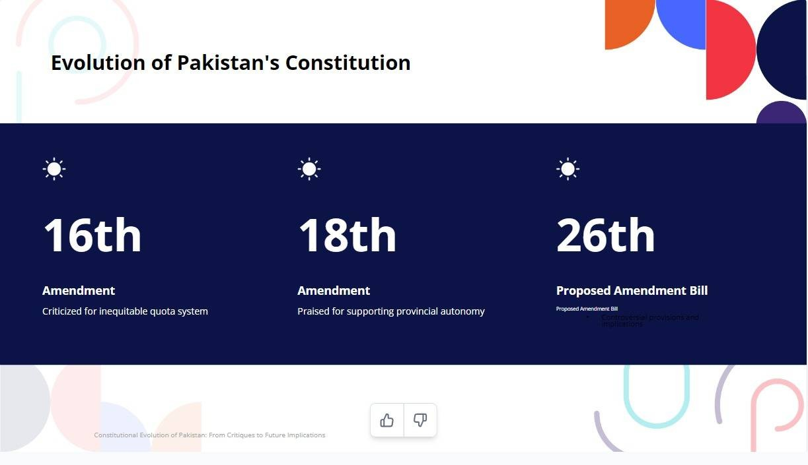
CamScanner

Slide 4

CamScanner

Slide 5
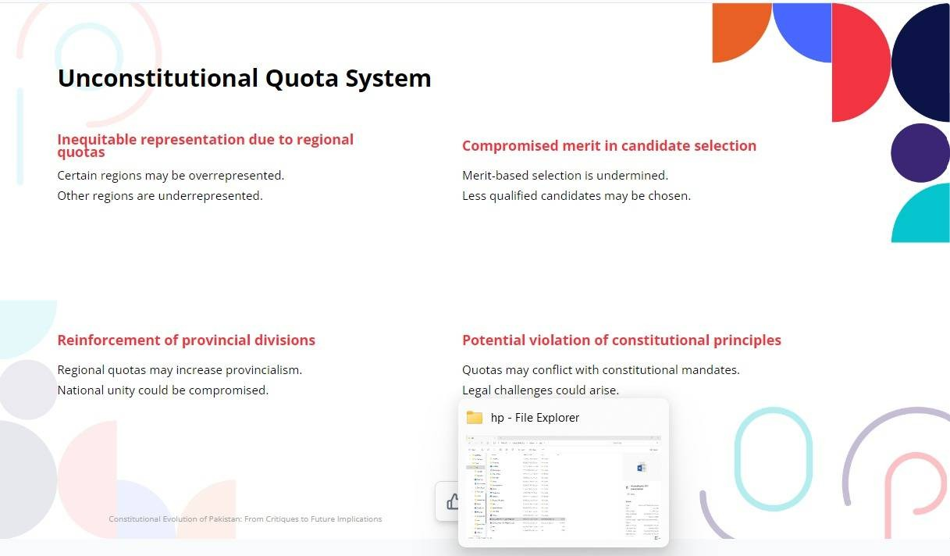
CamScanner

Slide 6

CamScanner

Slide 7

CamScanner

Slide 8
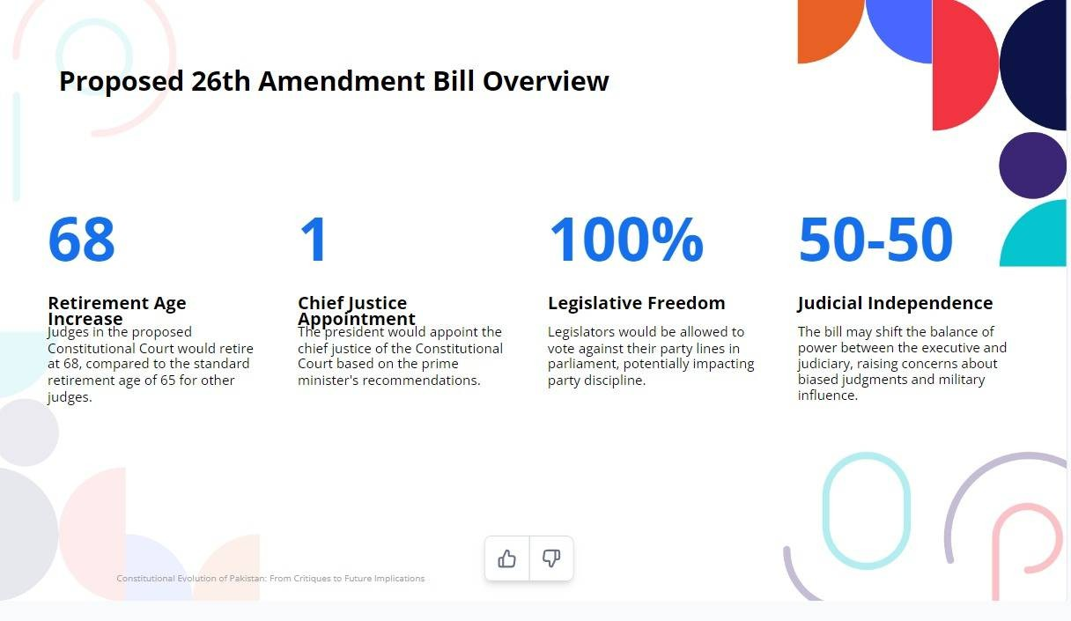
CamScanner

Slide 9
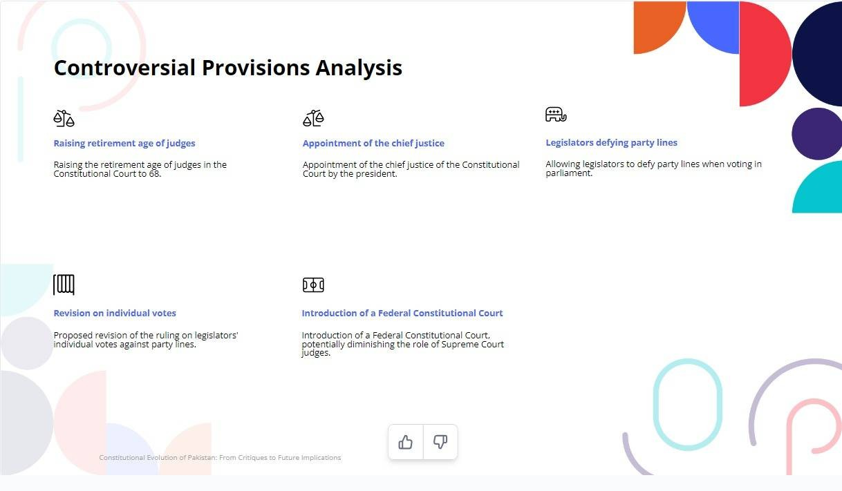
CamScanner

Slide 10

CamScanner

Slide 11

CamScanner

Slide 12

CamScanner

